Slide 1
Astro on Tap Trivia!
Pick up a quiz form in front
Answer the questions
Put form in box at front
Win kick-ass prizes
NO CHEATING ALLOWED
NO CELLPHONES
NO SHOUTING ANSWERS!
PLAY INVIDUALLY OR IN GROUPS
Astro Grads, postdocs, professors are ineligible

Slide 2
Question 1
Which stellar phenomena are known to release Gamma-Ray Bursts?
Some Supernova | b) Neutron Star Collisions
c) Neutron star-black hole collisions | d) All of the Above
Notes:
b) All of the above

Slide 3
Question 2
How did Tycho Brahe lose the tip of his nose?
Frostbite trying to find the Northwest Passage | b)In a duel about math
c) Brewhouse fight over a girl | d) Leprosy
Notes:
b) Duel about math

Slide 4

Question 3
Chrisjen Avasarala, played by Shohreh Agghdashloo, is a character in which sci-fi show that depicts future inter-planetary political tension?
Notes:
TheExpanse

Slide 5
Question 4
What is the primary source of natural background radiation on Earth?
Cosmic Rays | b) Radon Gas
c) Solar Radiation | d) Nuclear power plants
Notes:
D – nuclear power plants

Slide 6
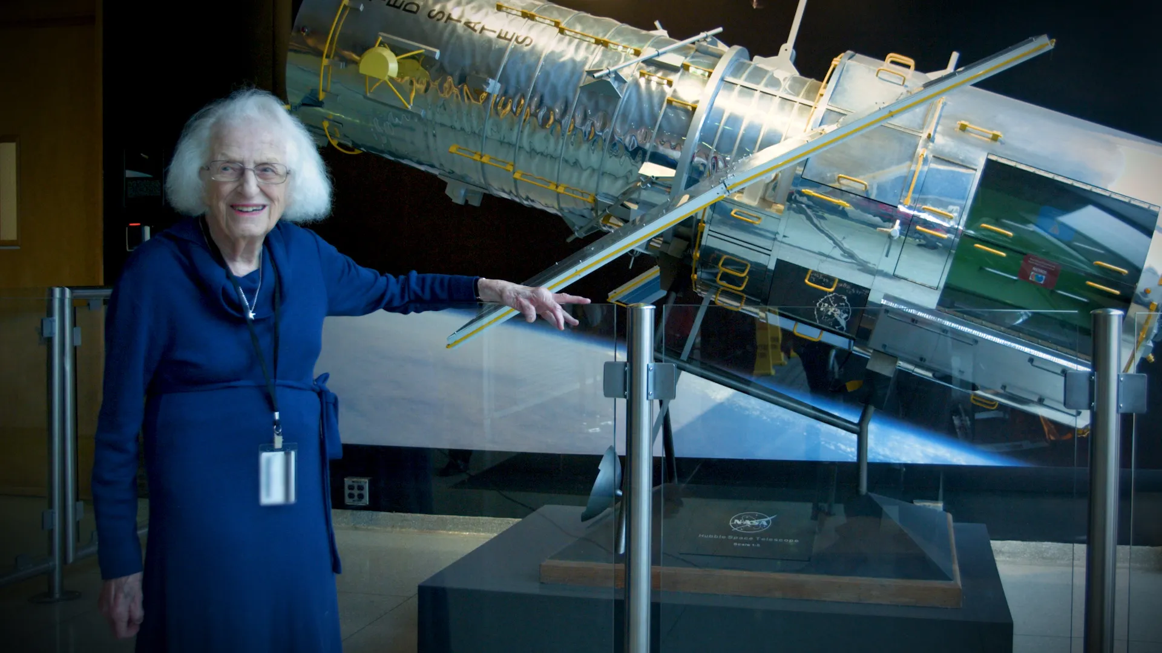
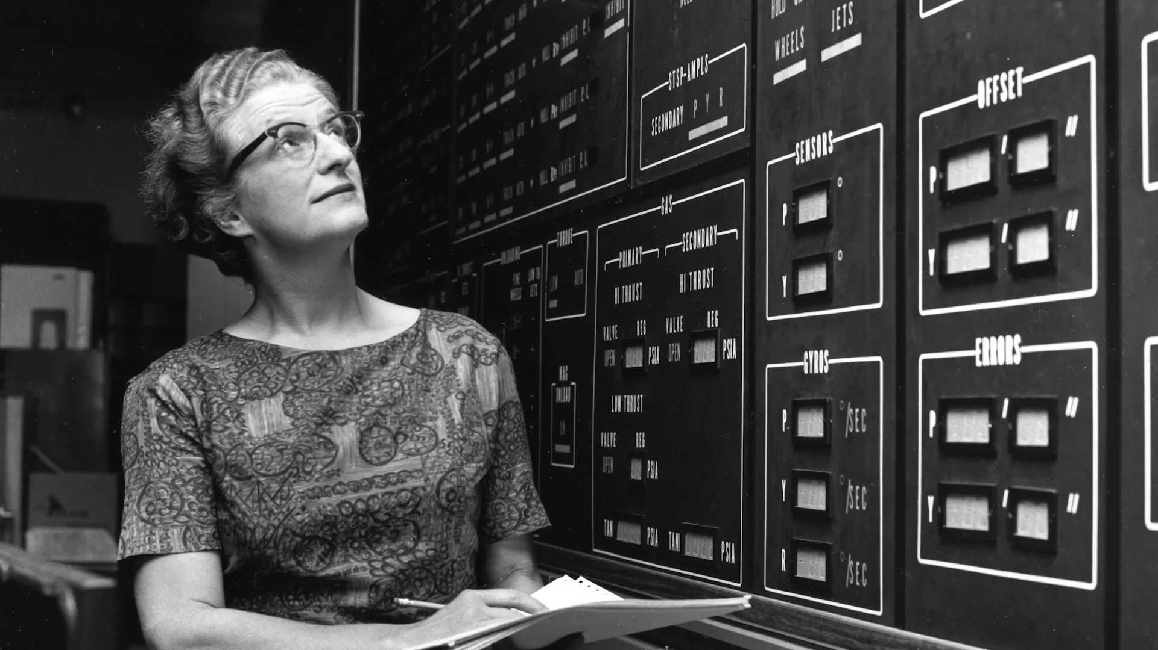
Question 5
Which future space telescope is named after a Nashville born astronomer aka
“The Mother of Hubble”
Notes:
Nanacy Grace Roman

Slide 7
Question 6
Which electronic music duo produced an album titled Random Access Memories in 2013, which features the track Contact, that includes audio from the Apollo 17 mission?
Notes:
Daft Punk

Slide 8
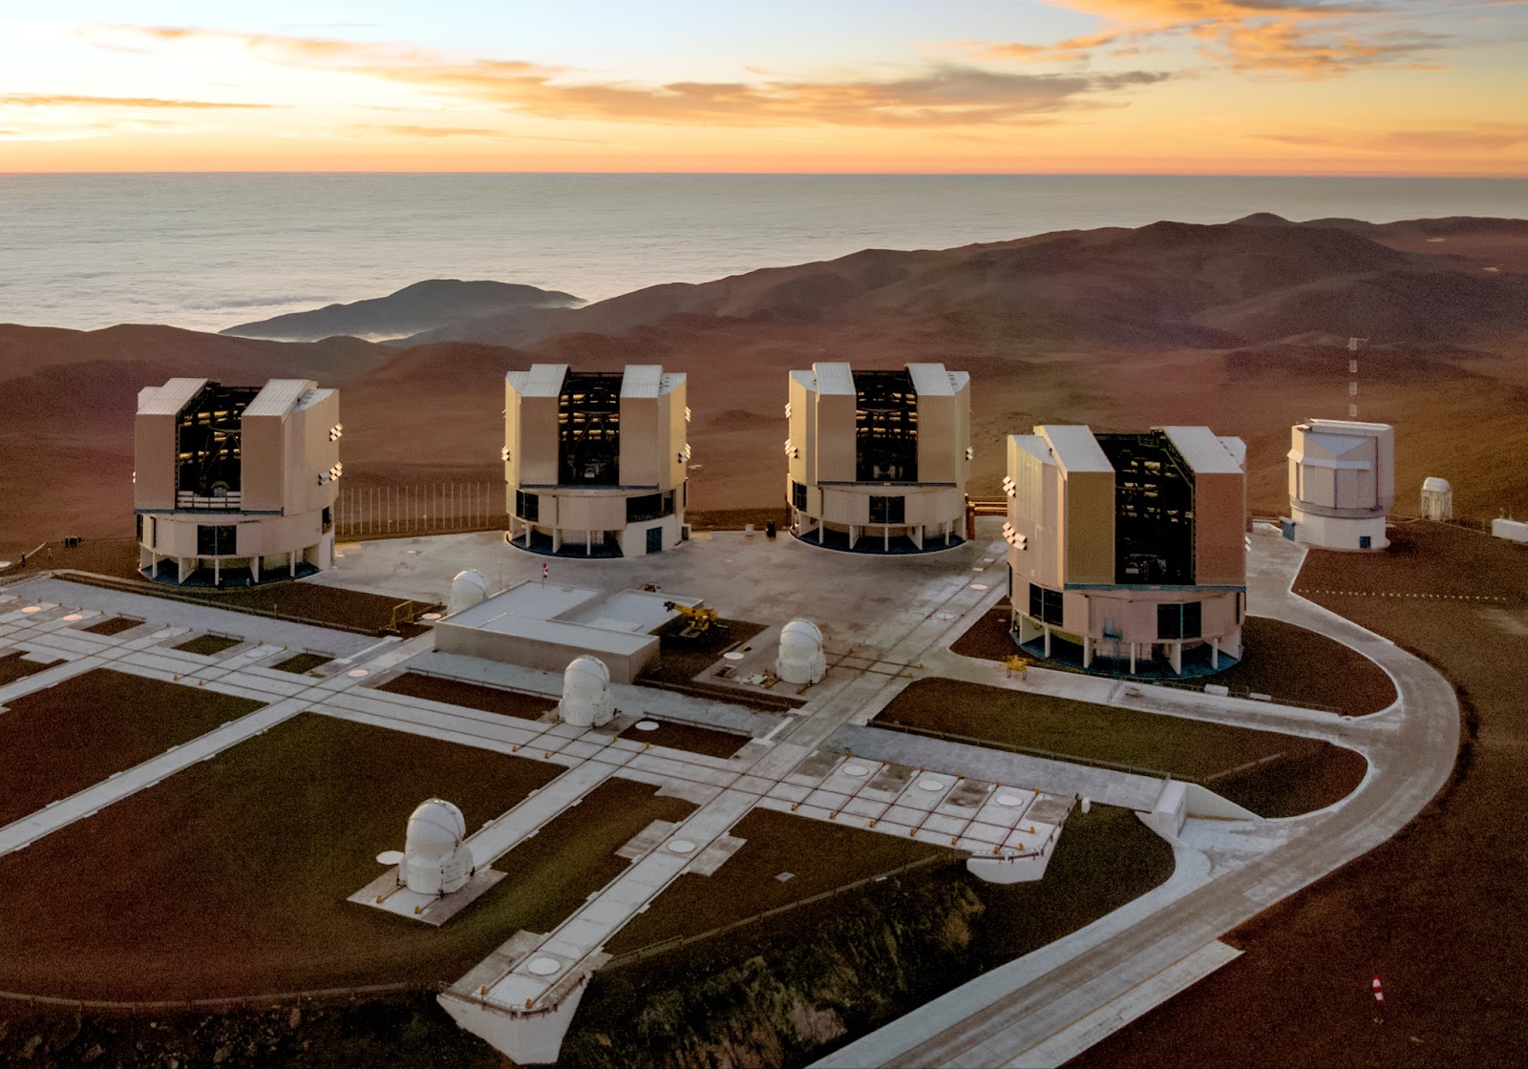
Question 7
The Paranal Observatory in Chile, hosts the…
FTI: Four Telescopes Interferometer
b) PBT: Paranal Bit Telescope
c) VLT: Very Large Telescope
d) SHT: Southern Huge Telescope
Notes:
c) - VLT

Slide 9
Question 8
Arguably, Kepler’s book on new astronomy stuff, is considered one of the most important books he’s written. What is the book’s original name?
Notes:
Astronomia Nova

Slide 10
Question 9
Which satellite became the closest human-made object to the surface of the Sun over the holidays?
Notes:
Parker solar probe

Slide 11
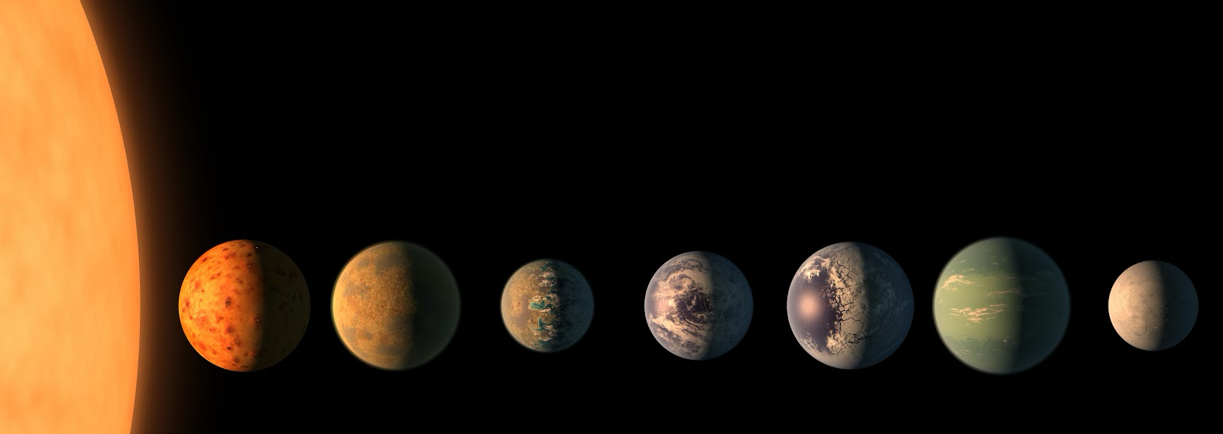
Question 10
The TRAPPIST-1 system consists of 7 planets orbiting a red star. The TRAPPIST telescope that discovered them is named after a group of...
monks
b) Beer brewers
c) anime cosplayers
d) Local turtle zoo
Notes:
a) monks

Slide 12
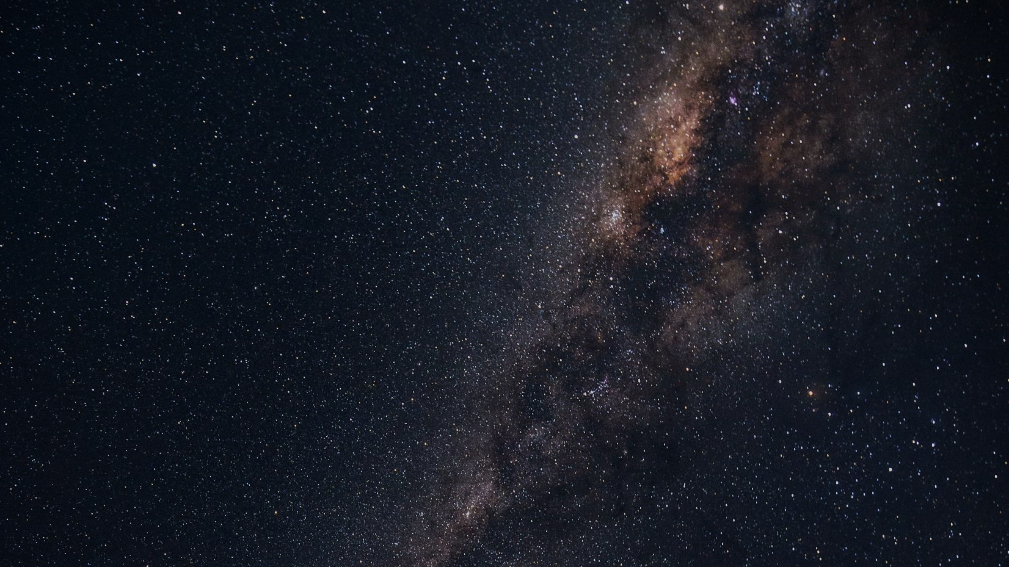

Don’t forget to tip your server/bartender!
Help us keep this a free event by donating any small amount
(e.g., $2, $5, $Googleplex)

